Slide 1
UNIT - I
Chapter – 1
Project and Project Environment

Slide 2


Slide 3
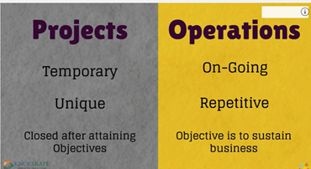

Slide 4
The Project Management Institute(PMI)
PMI is the professional organization devoted for furthering of project management.
PMI has done excellent job of defining the characteristics of projects through global standards.
Standards “when consistently applied, they help you ,your global peers and your organization achieve professional excellence.”
The most important standard published by PMI is Project Management Body of Knowledge)PMBOK.
PMBOK Guide is the standard for managing projects most of the time across many type of industries. This standard describes the project management processes, tools, and techniques used to manage a project towards a successful outcome.

Slide 5


Definitions
A project is a temporary endeavour undertaken to create a unique product or service.
It is
performed by people
constrained by limited resources
planned, executed and controlled

Slide 6
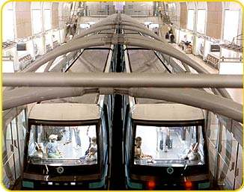
Examples
developing a new product or service
effecting change in a structure, staffing or style of an organisation
designing a new transportation vehicle
developing or acquiring a new or modified information system
constructing a building or facility
building a water system for a community in a developing country
running at campaign for political office

Slide 7
Project features
Temporary
A project has a definite beginning and definite end
The duration of a project is finite
The opportunity or market window is usually temporary, most projects have a limited time frame in which to produce the product or service
The project team - as a team - seldom outlives the project. Most projects are performed by a team created for the sole purpose of performing the project
Unique result
Projects involve doing something that has not been done before in the same environment
The project may require some innovation to be completed

Slide 8
Characteristics of project

Slide 9
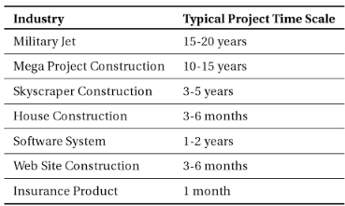
Project Time - scales
Timelines or scales are used to help team members to know what milestones need to be achieved and under what time schedule.

Slide 10
Project Management
Process of managing projects
PIM defines project management as:
PMBOK(Project Management Body of Knowledge) provide guidelines for managing individual projects. It defines project management and related concepts and describes project management lifecycle and the related processes.

Slide 11
Four PMBOK risk processes:
Identify Risks
Perform Quantitative Risk Analysis
Perform Qualitative Risk Analysis
Plan Risk Responses
Since every project is unique, no two life cycles will be same.
If the project is mission critical, or if the project team is not experienced, one should use more rigor in implementing and executing each process.

Slide 12
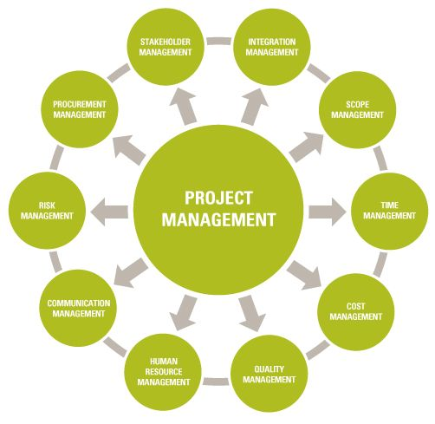

Slide 13
Who is responsible to achieve the objectives of the project ????
-The project manager
A project manager needs two types of skills
Sociocultural Skills-The project manager interacts with diverse stakeholders. Referred to as soft skills, and include general management skills, interpersonal communications and staff development.
Technical Skills- Technical analysis such as determining the value of the project to stakeholders, performing a cost estimate, constructing a work breakdown structure, building a network diagram, determining if the project is on schedule, whether it is over or under budget.

Slide 14
Technical Skills | Sociocultural Skills
Scope Production | Stakeholder Management
Work Breakdown Structure | General Management
Cost and Schedule Management | Staff Management
Resource Contention | Leadership
Critical Path Management | Negotiation Skills
Earned value Management | Politics

Slide 15
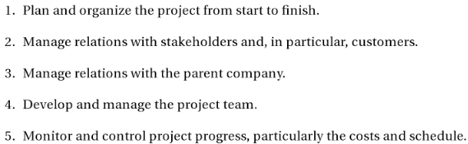

Role of Project Manager
Project Manager is the person assigned to achieve Project Objectives.

Slide 16
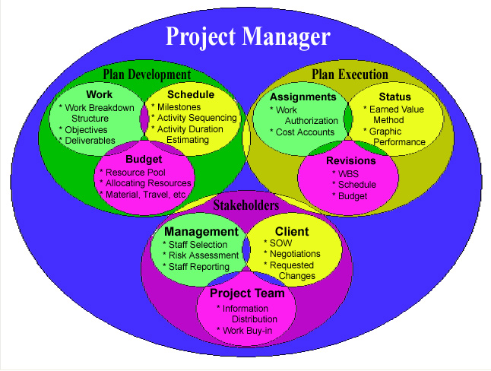
Project Manager Roles and Interactions

Slide 17
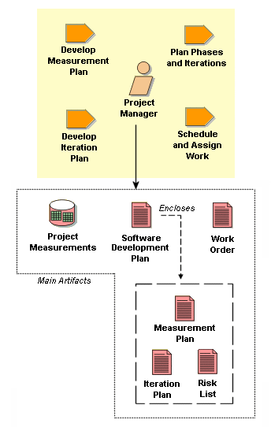
Project manager interacts with
Stakeholder
Upper Management
Sponsor
Customer
Project Team
Functional areas

Slide 18
Benefits of Project Management
You are not alone- There is a mountain of information available: literature, templates, advice. You can access it, learn form others. Some one has probably done something similar.
Powerful tools
Critical Path- Tells you which activity is the most important one to work on now.
Earned Value- How much your project is over the budget and behind the schedule.

Slide 19
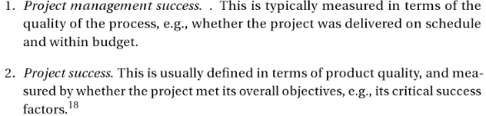
Success of PM

Slide 20
Project Failure
Is a complex concept.
Is a Project failure if it successfully meets stakeholder needs but comes in late and over budget?
Is a Project successful if it is on time and on budget but leaves some stakeholder unhappy?
One of the most quoted sources of project failure is the CHAOS report by the Standish group who studied 365 companies with a total of 8380 information System Applications.
A project with 25% of over budget that meets the stakeholder needs and is on time is a failure according to the Standish criteria.

Slide 21
CHAOS data on project failure
Project Outcome | 1994 | 2009 | Definition
Successful | 16% | 32% | Completed on time and budget
Challenged | 53% | 44% | Completed, but over budget, over budget
Impaired/Failed | 31% | 24% | Abandoned or cancelled

Slide 22
Project Environment
Project manager should be aware:

Slide 23
Internal Environment
Corporate culture that acknowledges and appreciates the effort of team members.
Good working, relationships ,among team members
Clear and open communications
An environment of trust
A willingness to take risks
Recognition of efforts and achievements

Slide 24
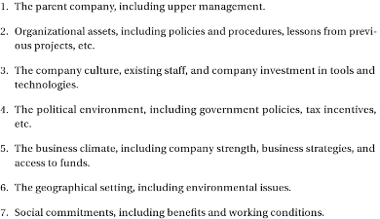
External Environment

Slide 25
Programs
Company’s marketing department creates a program to launch a new product.
Launch the product at a national trade show
Plan and implement a marketing campaign
Create new marketing channels for the projects
Examples of program
NASA’s Mars exploration

Slide 26

Hence program is defined as….

Slide 27
Project Management Office
Responsible for coordinated management of projects
Job of PMO:
Is a group or department within a business, agency or enterprise that defines and maintains standards for project management within the organization
Invest in project management technology, best practices, tools and techniques, and implement them across projects.
Manage the information technology system
Supervise functions that are managed centrally, such as the portfolio selection system
Collect and manage lessons learned

Slide 28
Portfolios
An entity that is managed from a business perspective.
Consists of all the activities necessary to make a product successful

Slide 29


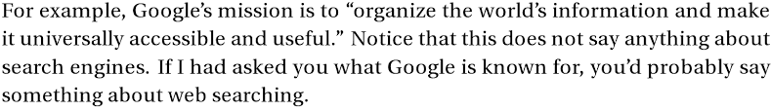
Mission,Goals,Objectives, Scope
Who???
Why???
What???
Mission – Accomplish excellence in the field of Technical Education through Education, Research and Service needs of the Society.

Slide 30
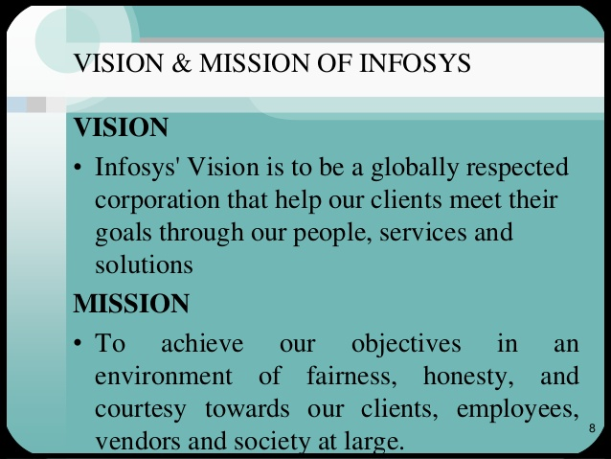

Slide 31

Goal
Goal is what you wish to accomplish
E.g:: Diversify our products to get new market

Slide 32
Objectives - SMARTO criteria
- Specific statements about what the company wishes to achieve
Eg: Increase market share by 15% in 3 years
S | Specific | In the target objective
M | Measurable | Indicators of progress
A | Assignable | To a specific person
R | Realistic | In what can be done
T | Timed | With schedules and deliverables
O | Open | For everyone to see

Slide 33
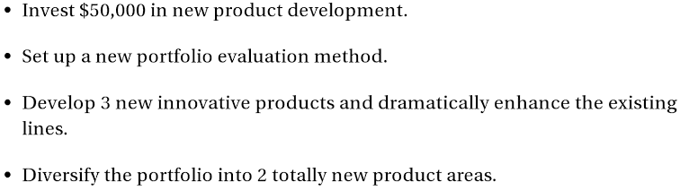
Strategy
- How the company will accomplish the objectives

Slide 34
A Portfolio Management System
Selection Criteria
Financial: payback, net present value (NPV), internal rate of return (IRR)
Non-financial: projects of strategic importance to the firm.
A good portfolio is characterized by
The right number of projects
Good Balance
Clearly tied to the business mission and Strategy

Slide 35
Critical Success Factors
A unique, differential product that provides significant benefits and superior value to the customer.
A strong market-driven, customer focused orientation at an “attractive market”.
Solid up-front project definition.
Don’t stray from core competencies.
Execute a disciplined process.

Slide 36
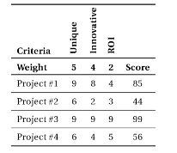
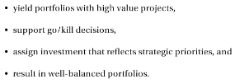
Scoring matrix

Slide 37
PMA Project Selection
Project Management Association(PMA) is considering implementing several new projects.
Proposed new projects usually emerge from strategy sessions, internal solicitations throughout the company, and the marketing department.
Each project has a project manager and a charter.
Charter describes the project, its budget and the primary objectives.

Slide 38
PMA’s list of proposed projects is as follows:
1. A new website to communicate with members.
2. A fundraiser solicitation by email to members.
3. A course in project management for members.
4. A membership drive to increase the membership.
The CSFs
Criteria to evaluate the proposed projects.
Research
Education
Growth

Slide 39
The Scoring Matrix
Score | Definitions for Scoring the criteria
9-10 | Valuable research information for most members.
7-8 | Valuable research information for any members, or useful capabilities for majority of members.
4-7 | Research information useable by a few members.
0-3 | No useful research information.
Fig. Scoring values
Criteria | Research | Education | Growth
weight | 5 | 4 | 2 | Score
Web site | 9 | 8 | 4 | 85
Fundraiser | 2 | 2 | 9 | 36
PM course | 0 | 10 | 7 | 54
Membership | 0 | 0 | 8 | 16
Fig. Scoring Matrix

Slide 40
Budget
The budget Allocated is $10,000
Criteria | Research | Education | Growth
Funded projects
weight | 5 | 4 | 2 | Score | Budget | Allocated
Web site | 9 | 8 | 4 | 85 | 5,000 | 5,000
Fundraiser | 2 | 2 | 9 | 36 | 5,000 | 10,000
Losers
PM course | 0 | 10 | 7 | 54 | 1,000 | 11,000
Membership | 0 | 0 | 8 | 16 | 1,000 | 12,000

Slide 41
Projects are funded until we reach the allocated amount, which here is $10,000. The fundraiser and Membership Product do not get funded.
The Strategy
The final step is to decide if the funded projects make sense from a strategic perspective as a group.
Look at the synergy between the products.
Committee evaluating can make changes, such as:
1. Cut the budgets.
2.Combine Similar Projects.
3.Beware of “ false precision”.
4.Conduct a sensitivity analysis.

Slide 42
Calibration
Calibration is accomplished by having the organization go through the scoring process using historical projects.
Small teams are assigned to score a set of projects.
The team first suggest values for the weights.
Teams use agreed upon weights to score projects.
If the weights are correct , the company’s most successful project will be at the top of the list.

Slide 43
Setting up a selection process
Calibration of weights.
Selecting new projects.

Slide 44

Financial Models
The Payback Model
Measures the time the project will take to recover the project investment.
Uses more desirable shorter paybacks.
Emphasizes cash flows, a key factor in business.

Slide 45
Financial Models (cont’d)
The Net Present Value (NPV) model
Uses management’s minimum desired rate-of-return (discount rate) to compute the present value of all net cash inflows.
Positive NPV: project meets minimum desired rate of return and is eligible for further consideration.
Negative NPV: project is rejected.

Slide 46
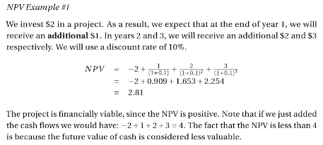
NPV : Problem 1

Slide 47
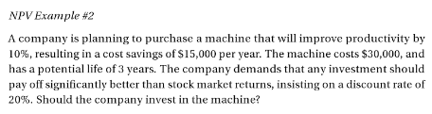

Slide 48
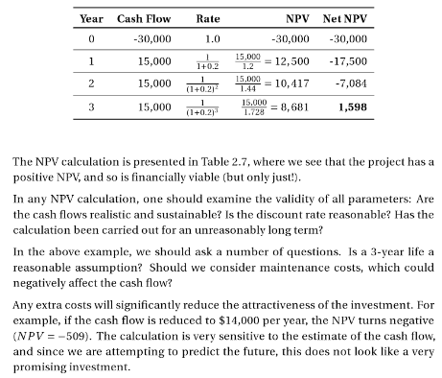
Problem 2 ….(Cont’d)

